Slide 1


Smart Home
Final project

Slide 2
Project team
MOHAMMED REFAT (22)
MAHMOUD GAMAL (17)
OMAR MOHAMED YOUSSEF (27)
MAHMOUD SOLIMAN
ABDELALIEEM AHMED (09)

Slide 3
Project About
Our Smart IOT System has a door lock with a password and alarm system to notify us if someone one try to enter the house.
Inside the house there is a light system we can control using web app or using sensors Like PIR Sensor.
Also there will be a temperature sensors and LCD screen to display the temperature (but this feature is optional).

Slide 4
Components:
STMF401CC
LCD
Keypad
Motor
PIR sensor
Buzzer
LED
Wifi Module
LM35 (option)

Slide 5
Software Architecture
MCAL:
RCC
GPIO
SYSTICK
NVIC
EXTI
USART
ADC(option)
HAL:
LED
BUZZER
LCD
Keypad
Motor
PIR

Slide 6
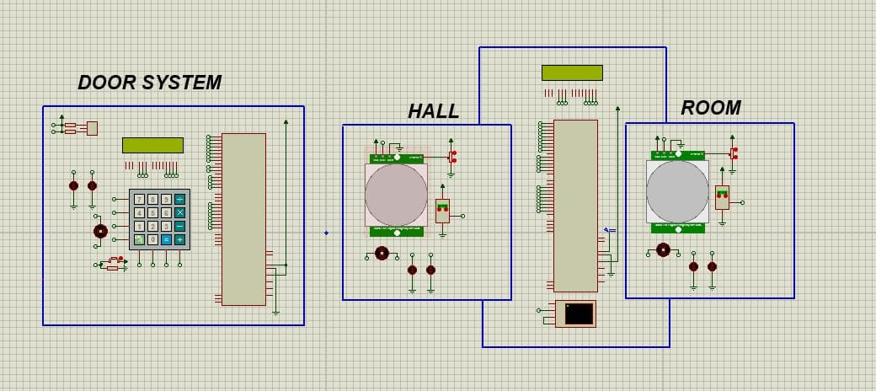
Proteus Design

Slide 7
DESCRIPTION of OUR PROJECT
it is our system now. Smart home, In the basic needs, The first thing is the door system, It will be the first thing that I will set password, After what is left, I will stay with the password, If I entered the password, it is rightly, which will enter me on the system and open the door, In the event that I entered the password wrongly, I will have three attempts, After every attempt, you will miss me about two seconds, And then, after that, I can write the password again, And so on, This is what is the security or part of the door.

Slide 8
DESCRIPTION of OUR PROJECT
The second part remains, which is the part that we have a hall, and we have the room, We have three basic needs in each part of the home, We have 2 LEDs, one white and one yellow, We have an air conditioner that is dc motor, we have a pir sensor, and we have LM35 sensor, Ok, I am in control. How do you get on the sensor or on the LEDs and the conditioner through the Bluetooth module, which is through UART by sending a command and every specific command or every number of a certain number, so it will be for a certain action that is taken, so if you sell one, the first hand will work, The air conditioner extinguishes, and so on, what is the need that I am doing with a control via Bluetooth Model, and I can use it through pir sensor, I still have two types of control only, Who is Pir sensor or B Bluetooth Module.

